Slide 1

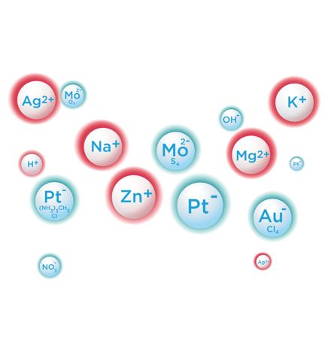


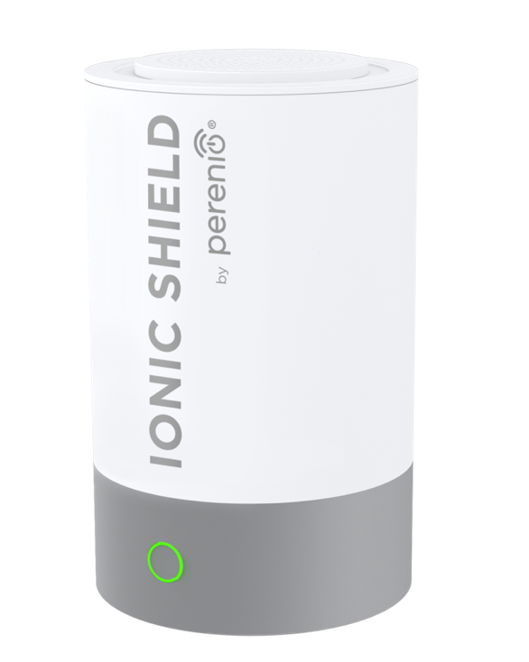



^{COLD PLASMA}
^{EMITTER}
With CoV capsule of complex metal ions Effective against:
Human Coronavirus, Influenza A
According to laboratory tests, PERENIO through Cold Plasma technology reduces the viral load in the air

Slide 2



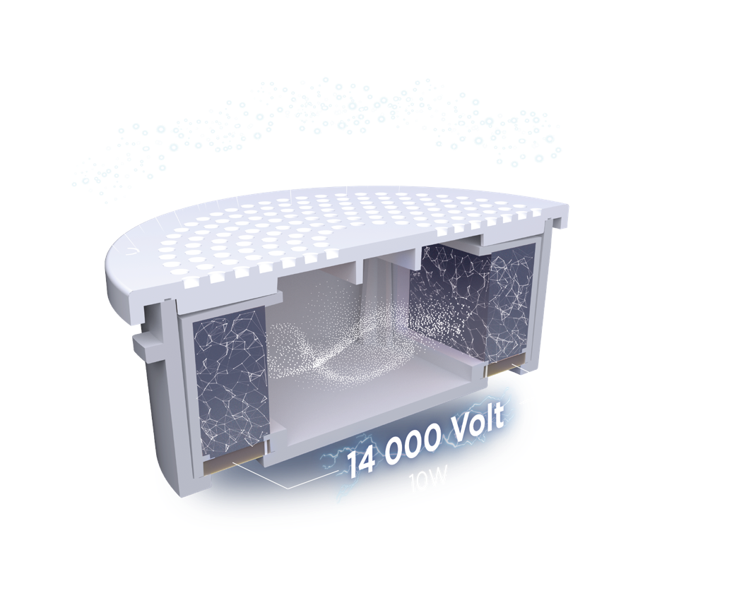

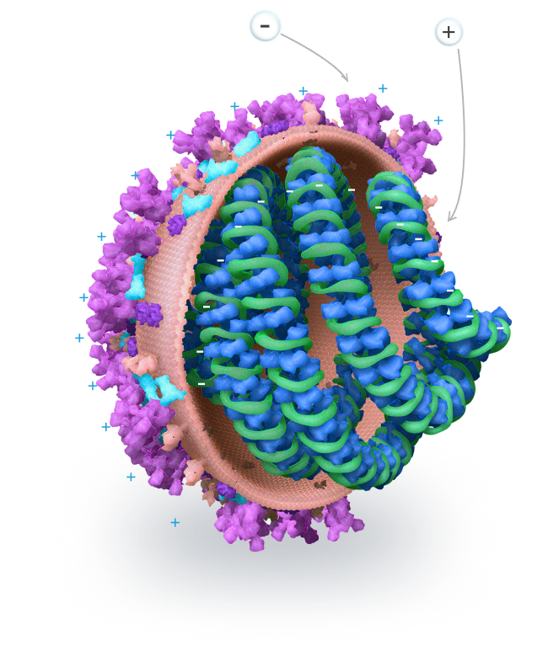
HOW IT WORKS
The cold plasma is invisible to the eyes, activated device creates the shield of metal ions from the capsule
This shield is the semi-sphere with a volume of approximately 3 m³
The «-» metal ions “burn” the “+” membrane of the virus leading to its destruction

Slide 3
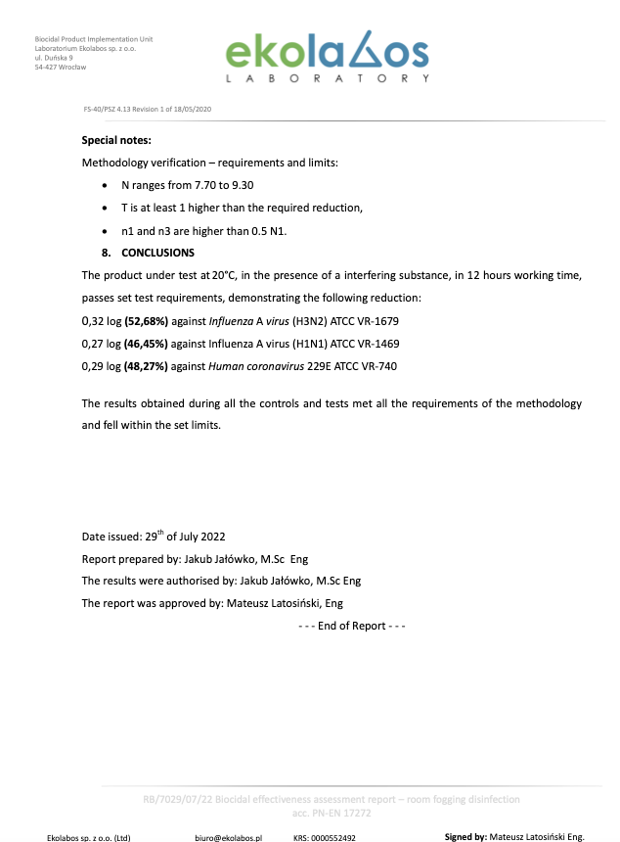
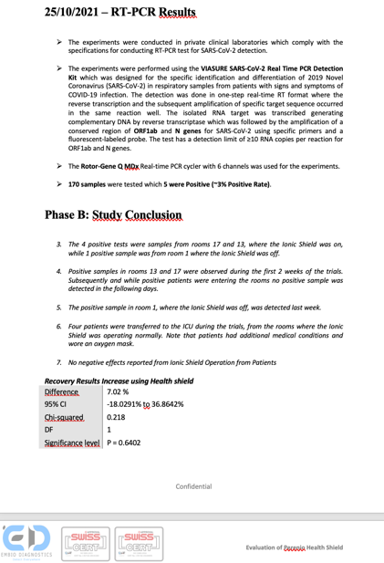
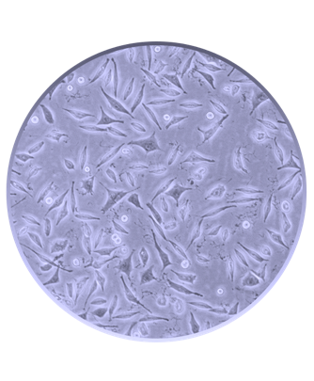
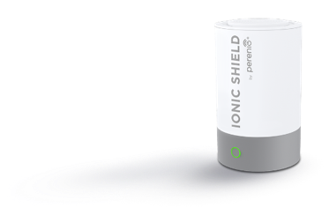
IT'S PROVEN
According to laboratory tests, PERENIO through Cold Plasma technology reduces the viral load in the air
86,2% Virus reduction percentage (Coronavirus 229) within 15 hours
Under test at 20°C, in 12 hours working time, demonstrating the following reduction:
- 52,7 % against Influenza A virus (H3N2) ATCC VR-1679
- 46,5 % against Influenza A virus (H1N1) ATCC VR-1469
- 48,3 % against Human Coronavirus (229E) ATCC VR-740
Perenio Ionic Shield is proved in following tests:
In-vitro culture test (more survived cells in activated device area)*
The evaluation methodology from the PN-EN 17272:2020-10**
PCR control with “VIASURE SARS-CoV-2 Real Time Kit”***
NO increasing OZON concentration in activated device area****
* “Sure Laboratories”, United Kingdom, ”Microbiological review of report D/21/V0177”
** “Ekolabos Laboratory”, Poland, "Biocidal effectiveness assessment report – room fogging disinfection “, 29.07.2022
*** Nicosia hospital, Cyprus, Clinical report, 25.10.2021
**** “Laboratory for comprehensive hygiene research”, February 2021

Slide 4

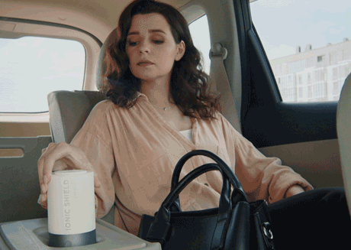
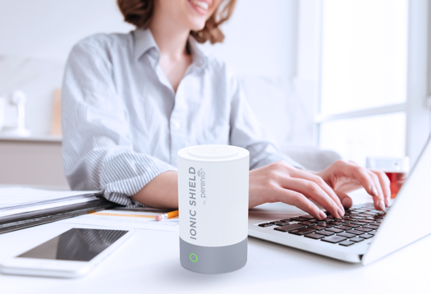
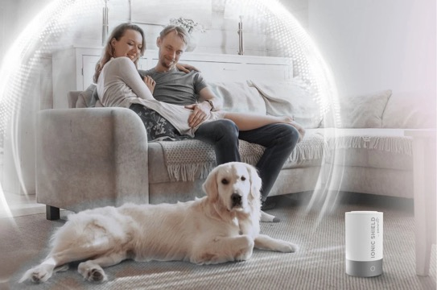
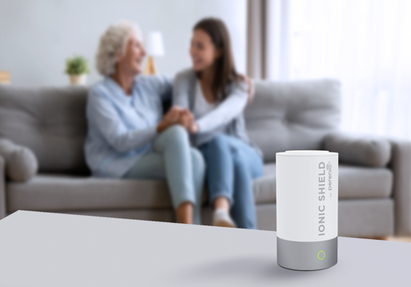
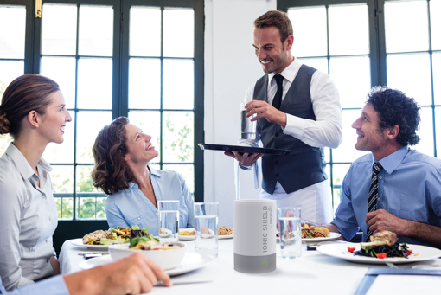
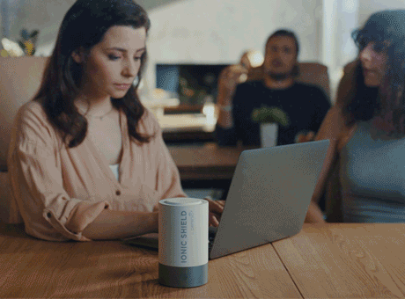
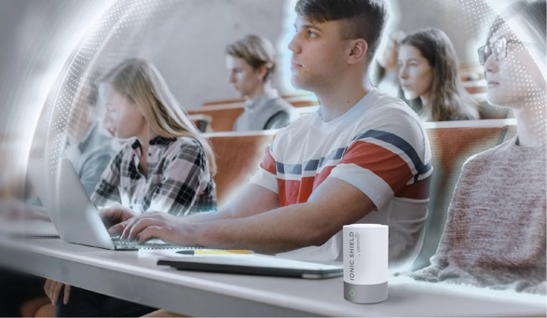


USE ANYWHERE
CAR
HOME-OFFICE
HOME WITH PETS
PARENTS’ PLACE
RESTAURANT
OFFICE
PUBLIC PLACES
HOTEL
Wherever you are being, whatever you are doing, PERENIO through Cold Plasma technology has been proven to reduce viral load in the air around you

Slide 5
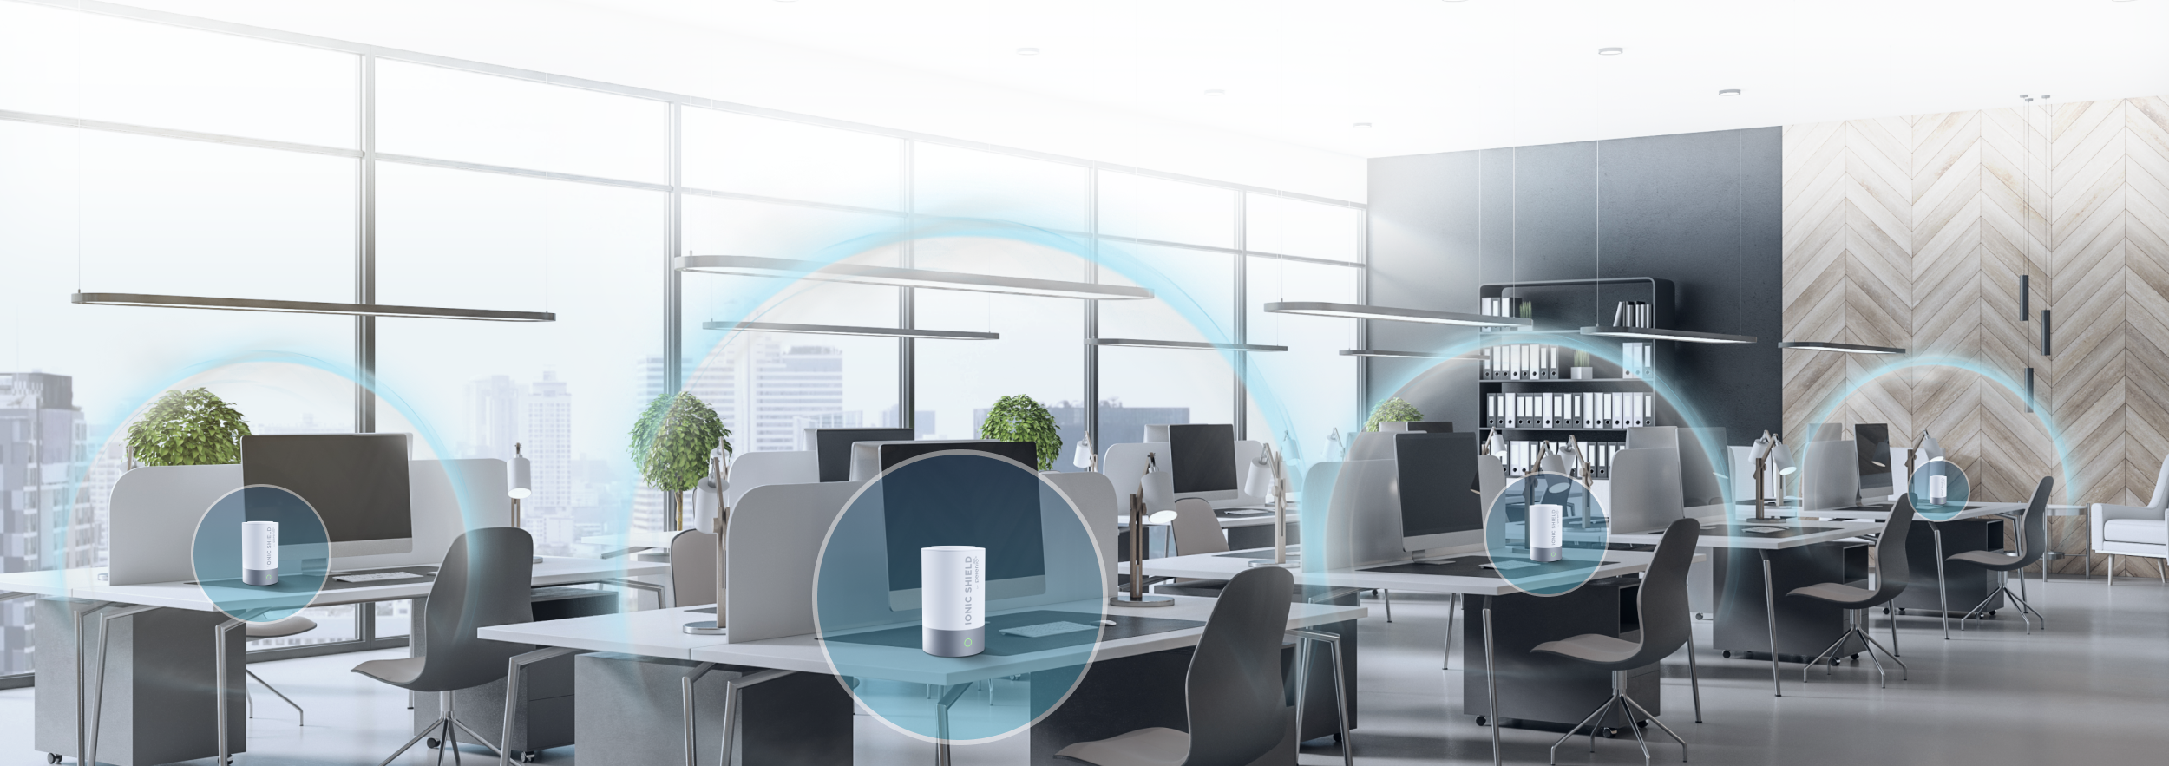
TO COVER LARGE CLOSED SPACES
How to equip open space office for safe from virus load?
S
/60m²
Office
space
=
Put Perenio Ionic Shield to cover every 60 square meters
The recommended distance between devices is 20 meters with a ceiling height of 3 meters
Use it also in public zones of open space
Use only during meetings in meeting room
+
Number of cold plasma emitters
Number of meeting rooms
20m
20m

Slide 6
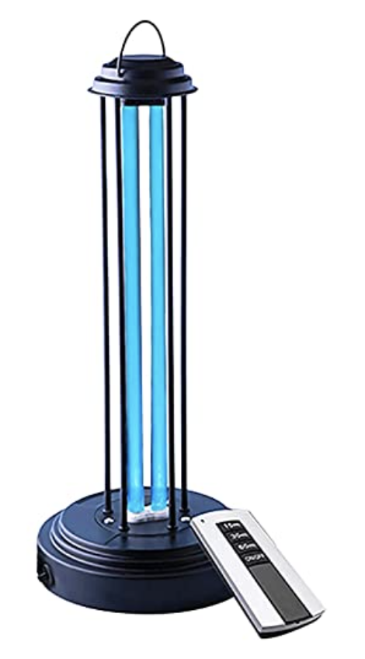
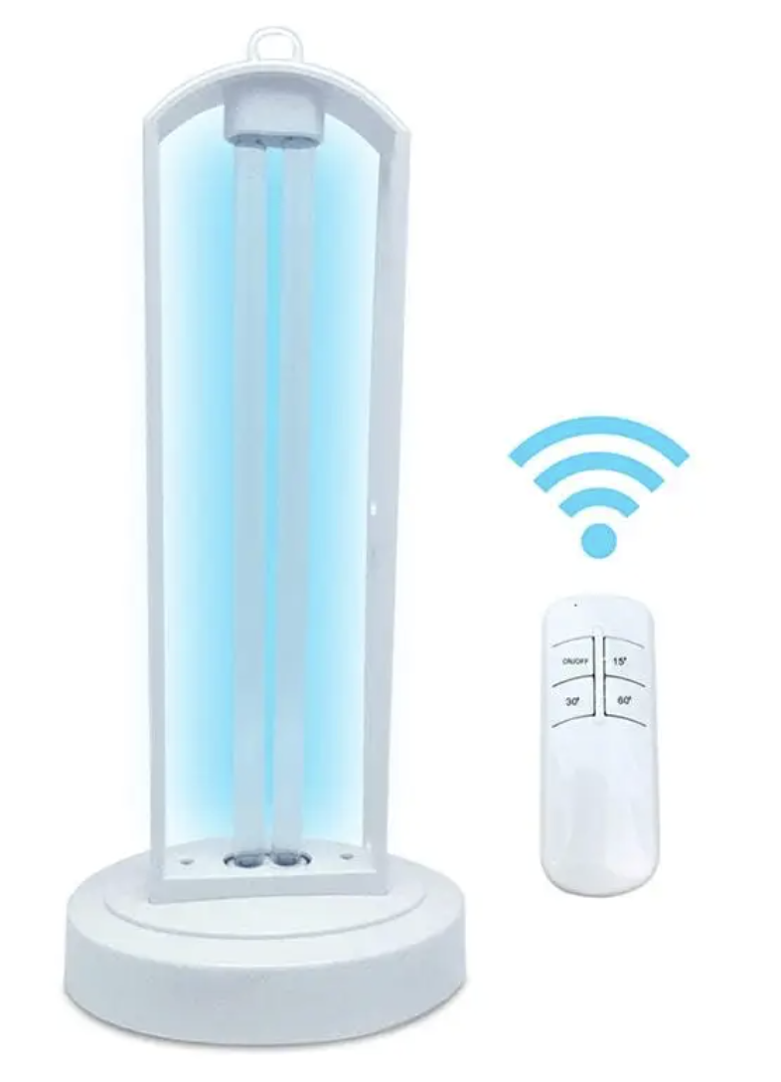
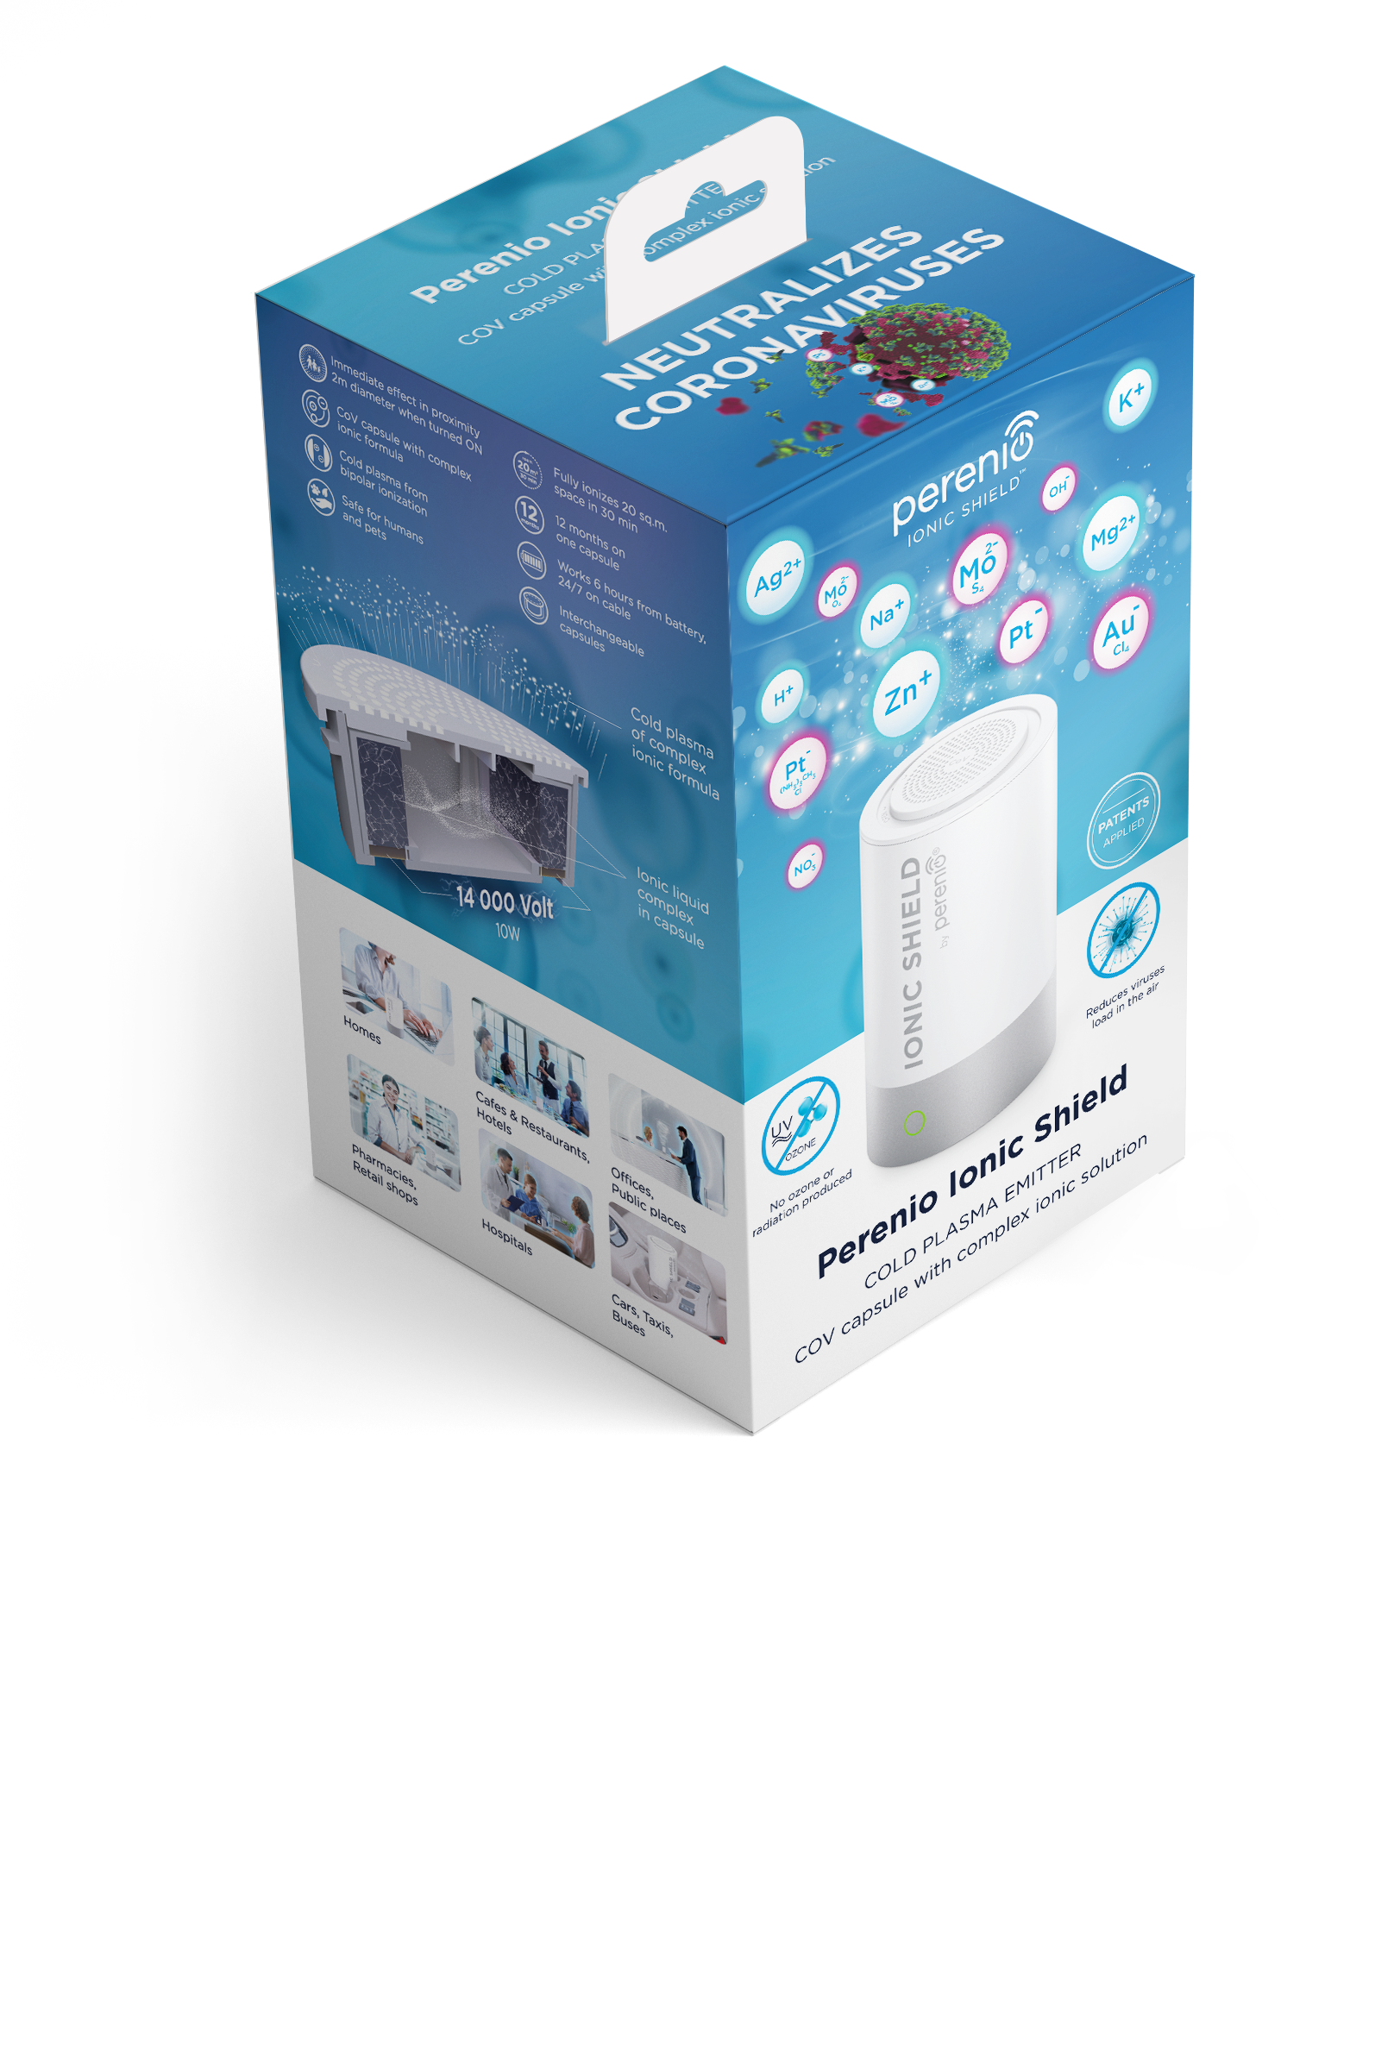
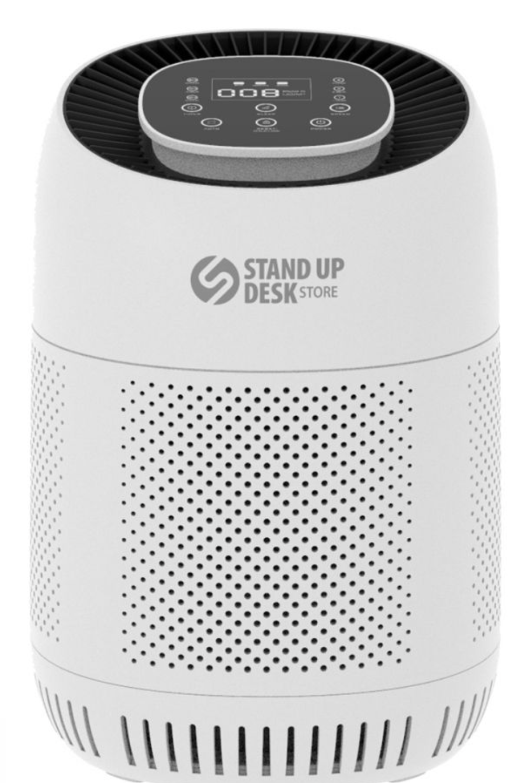
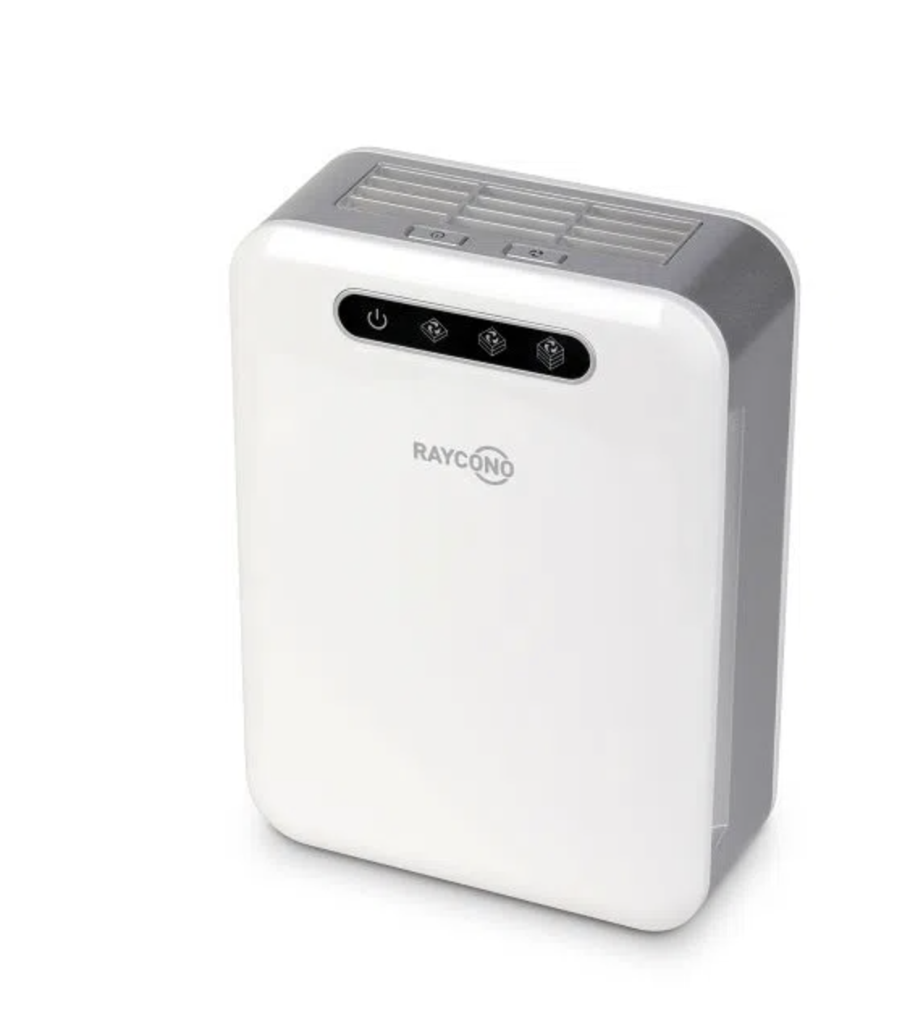
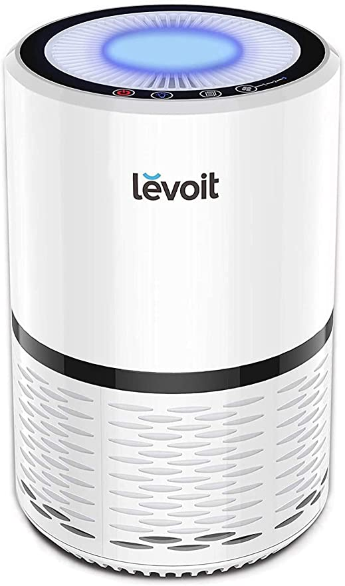
COMPETITORS
 | UV-C lights | Ozon lamps | Air-purifiers | Airborne ionizers | Hydroxyl sterilizers and air purifier | Perenio Ionic Shield
Possibility to use in the presence of humans | YES | NO | YES | YES | YES | YES
Antivirus efficiency in the air | NO | YES | LOW | NO | NO | YES
Antimicrobial efficiency in the air | NO | YES | LOW | NO | YES | YES
Has an independent power supply | YES | YES | YES | YES/NO (depends on size) | NO | YES
Emission | UV-C Rays | Ozone O₃ strong oxidizing agent | No emission | Ions from the air (O₂, N₂, N₂O) | Hydroxyl Radicals | High energy ions (K, Mg, Ag, Zn, H, Pt, Au)

Slide 7
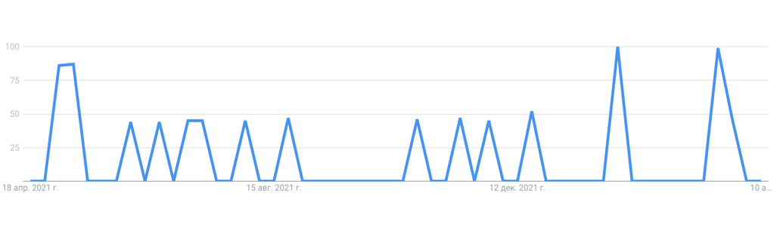
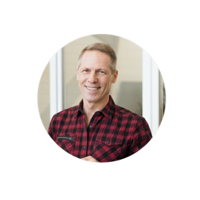

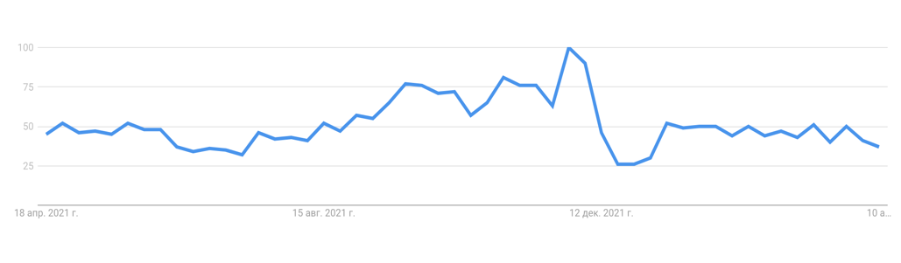

TARGET GROUP and DEMAND DRIVERS
There ate THREE targets:
Town-folks (20-60), all genders, interested in anti-viral protection
Owners/Administrators/HRs in legal entities with open spaces
Managers of big hospitals, taxi service and transportation companies (airports, stations etc.)
“how to protect yourself from FLU”
“how to decrease viral replication”
Source: https://trends.google.com

Slide 8
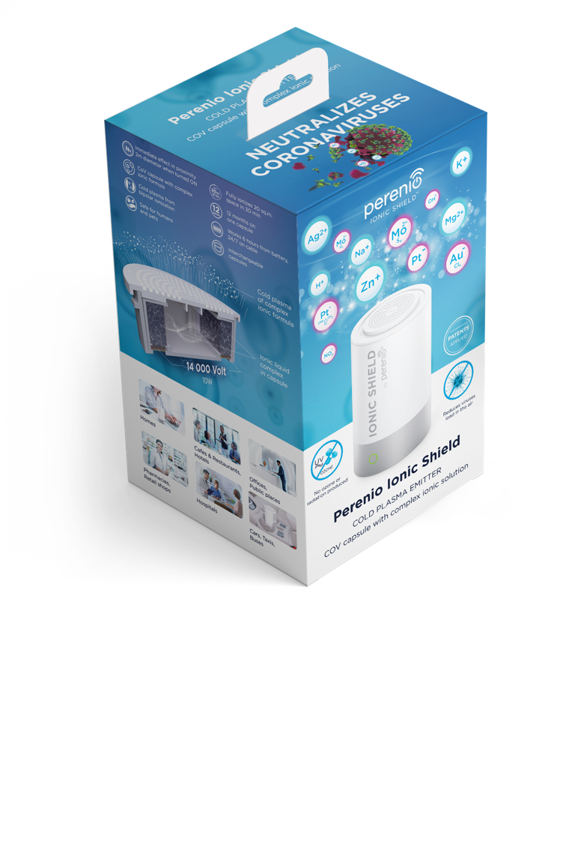
MARKETING MIX AND SUPPORT
Digital promotion
Media campaign in Global PERENIO site, Instagram and Facebook with traffic to the partners’ site
Paid media (traffic to the partners' site)
On-line support
Promotion in e-retail (highlighted product on the partners’ site)
Banners to support promo
Off-line support
Product stoppers in POS
Seasonal offers (FLU periods, winter vacations, back-to university) – “1 capsule for free”
Seasonal offers (FLU periods, winter vacations, back-to university) – “1 capsule for free”
Motivation for the sales staff in POS (SELL-OUT Champions)

Slide 9
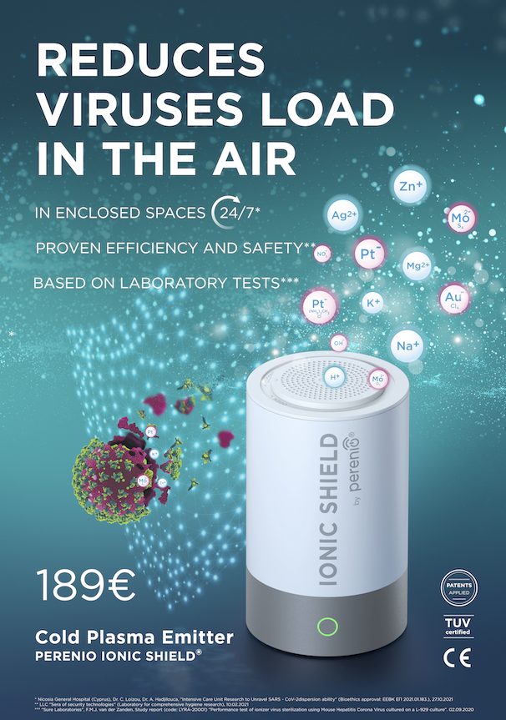
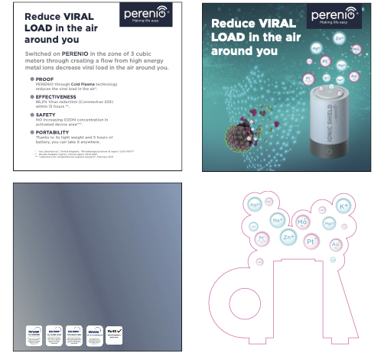
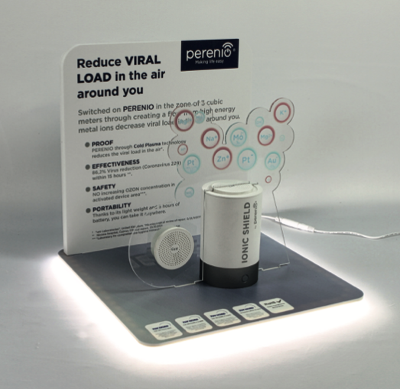
OFF-LINE Support
BTL Sales Support
Merchandising
Motivational programs for sales staff
POS staff motivation programs (in case of applicable)
Participation in partner commercial programs
In POS on-shelf + banner
Increases visibility and works for SELL-OUT
Simplify scientific messages and communicates directly to customers

Slide 10




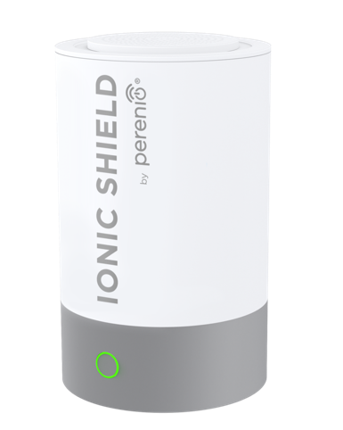





TECHNICAL SPECIFICATIONS
On / off button with indicator
5V, 2A, 10W
1.5m USB-A to USB-C cable
Changeable capsule COV
Power adapter, battery (5 h.)
Compact: 130 mm high and 80 mm in diameter
Lightweight: only 100 grams
80mm
130mm

Slide 11
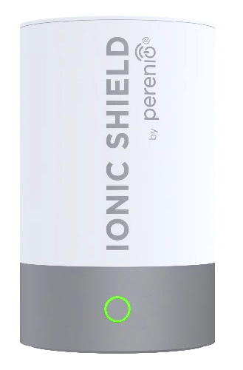

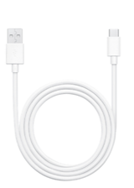
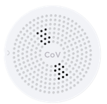
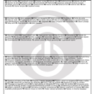
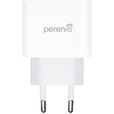
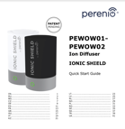

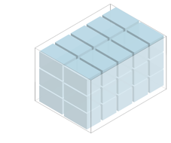



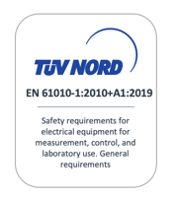
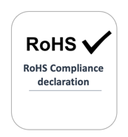
TECHNICAL SPECIFICATIONS
104mm
104mm
Ion Diffuser
Capsule
USB-A - USB-C
171mm
Power adapter
Quick Start Guide & Warranty card
Master carton
555x410x350mm – 30 pcs
Pallet - 20 cartons
5 boxes in layer, 4 layers

Slide 12
ASBISC ENTERPRISES PLC
43, Kolonakiou Street,
Diamond Court
4103, Ayios Athanasios,
Limassol, Cyprus
+371 262 26 065
d.minchenko@asbis.com

